Slide 1

CRM ANALYSIS
Submitted By;
Sherin Joseph
22/July/2021
Instructor:
Hamid Rajaee

Slide 2

INTRODUCTION
Customer churn is one of the major problems with companies.
The companies implement several strategies to retain their valuable customers.
Despite the service provided by the company, there are high chances for customer churn due to several factors such as market competition, financial situations and so on.
In this project, the wireless company would like to uses behavioral analysis to categorize customers and design strategies that will do to minimize customer attrition and sustain and maximize the activities of the most valuable customers.

Slide 3
Objective
The objective of Given today's marketplace demands, it is more important than ever for businesses to reduce customer attrition.
Gain valuable insight on why your relationships ended and what might have been done to preserve them.
Evaluate specific strengths, weaknesses and gaps within your product line, your client service delivery structure and your technology platform.
Based on the insights what need to be done to keep the existing customers to stay in business with the company.

Slide 4

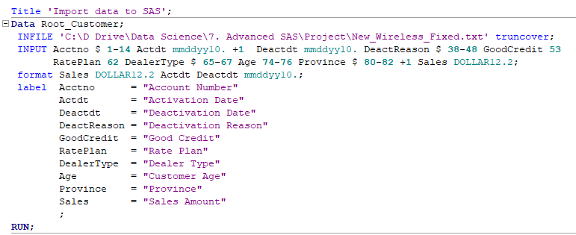
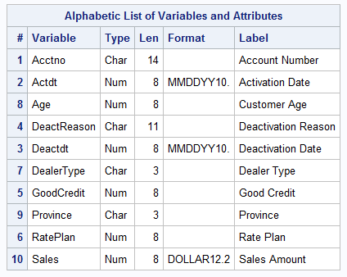
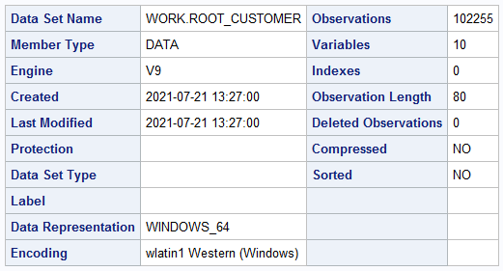
DATA SET
Importing Data
Familiarizing Data Set

Slide 5
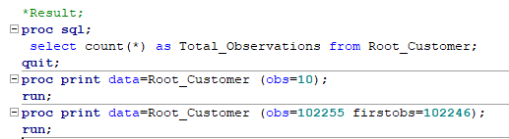
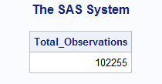
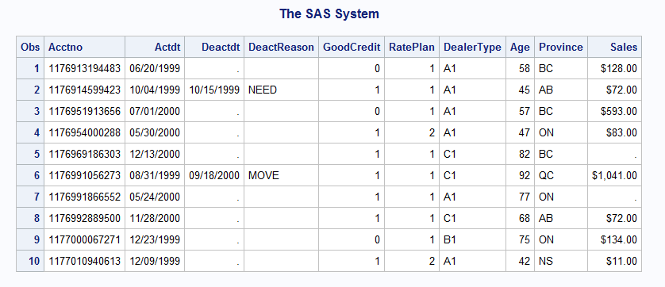
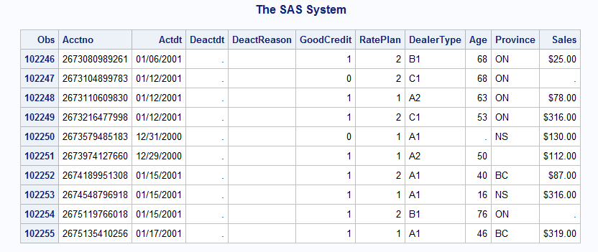
RESULTS

Slide 6

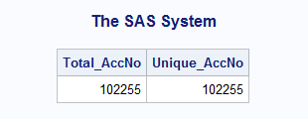
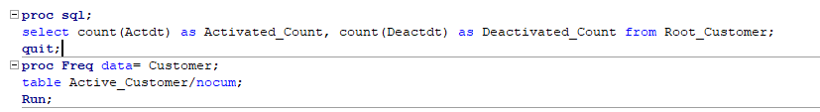
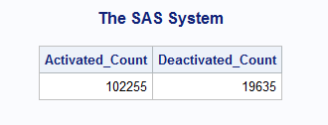
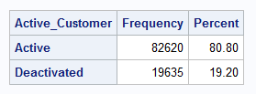
1.1 Explore and describe the dataset briefly
Is the Account Number Unique?
What is the number of accounts activated and deactivated?

Slide 7
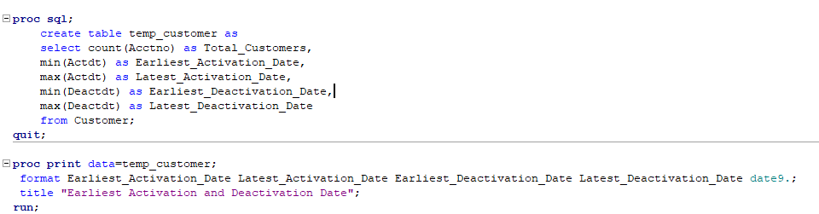
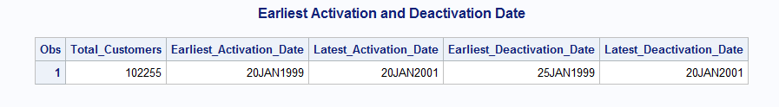
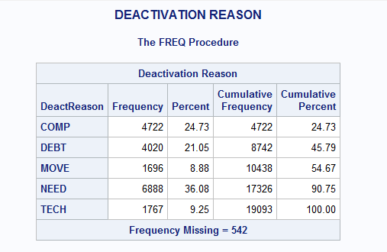
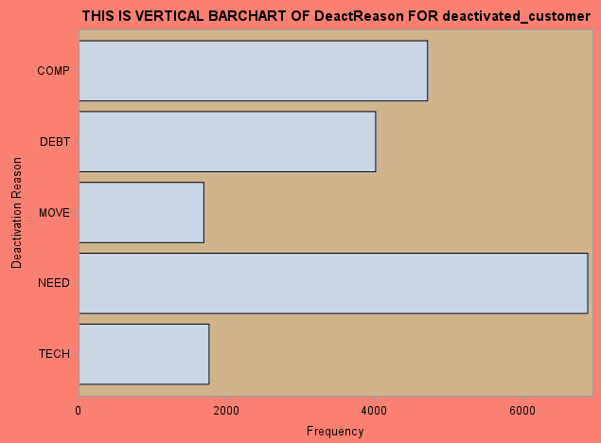

When is the earliest and latest activation/deactivation dates available?
What is the main reason for deactivation?

Slide 8
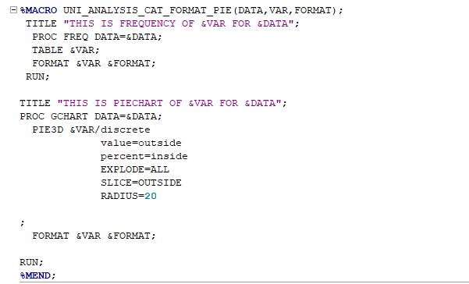
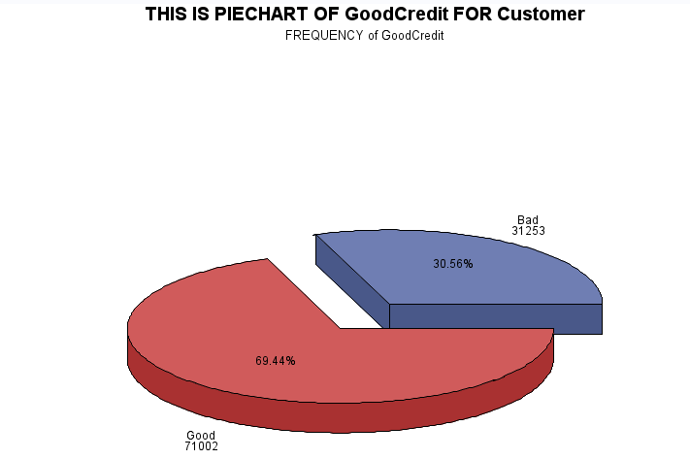
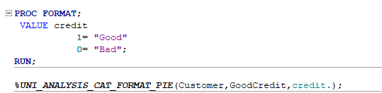
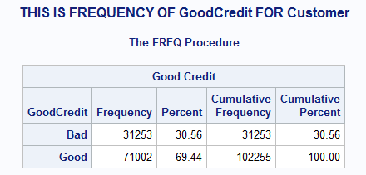
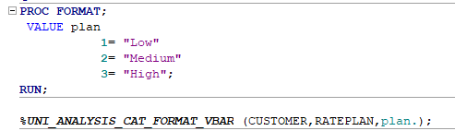
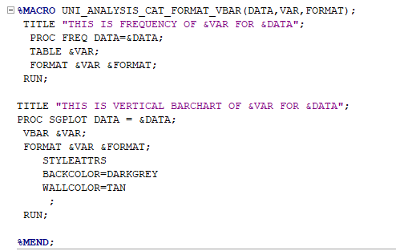
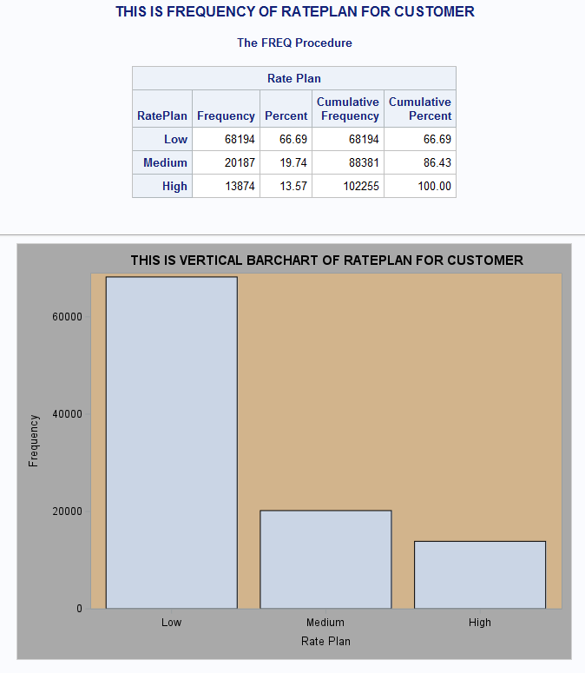
How many customers with good and bad credit?
Find the distribution of rate plans for customers are see the which plan has more customers.

Slide 9
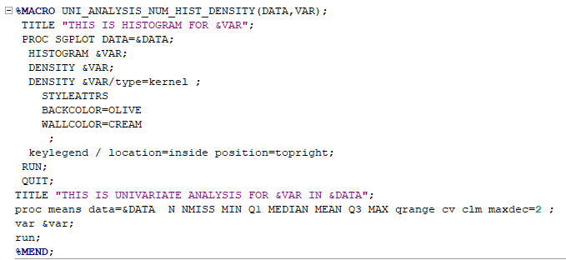
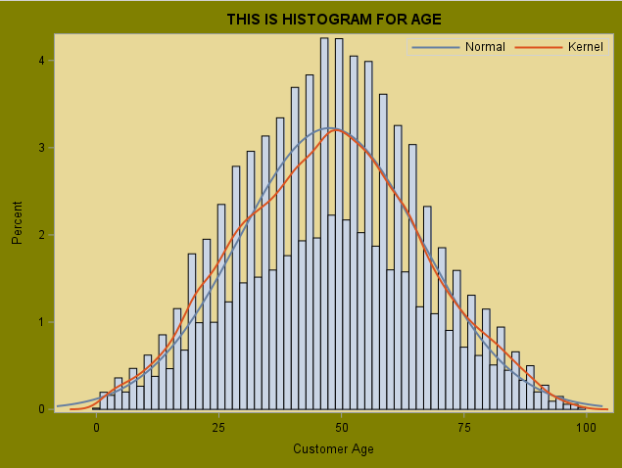
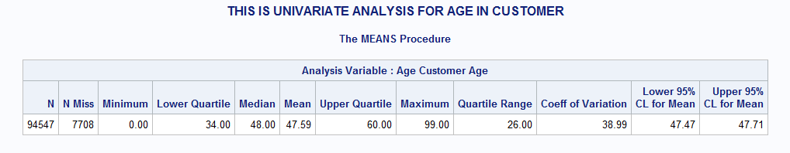
Find the distribution of Age of Customers.

Slide 10
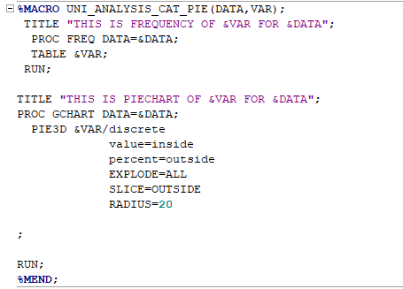
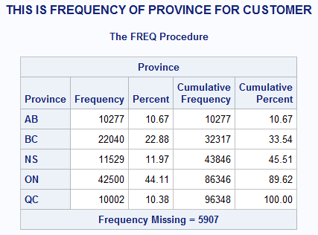
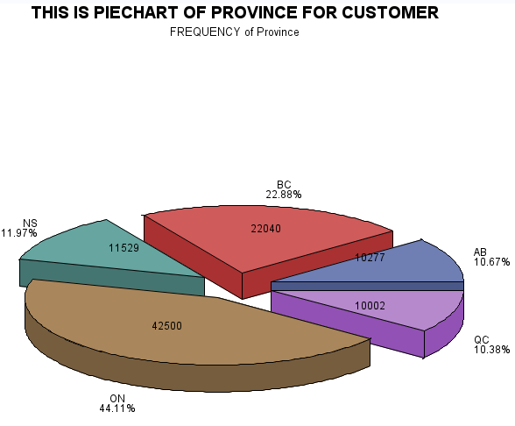

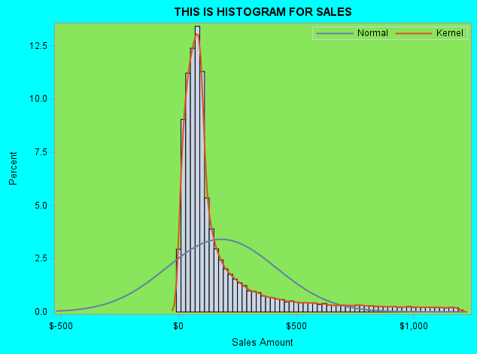
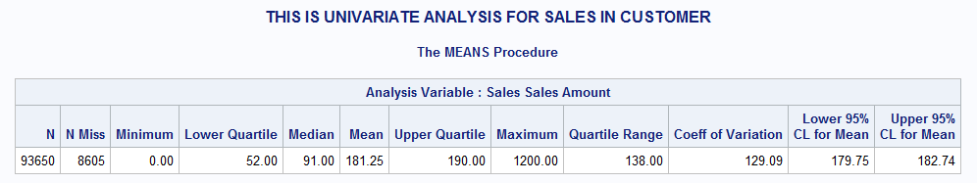
Which province has the maximum and min number of customers?
Find the distribution of Sales among customers

Slide 11
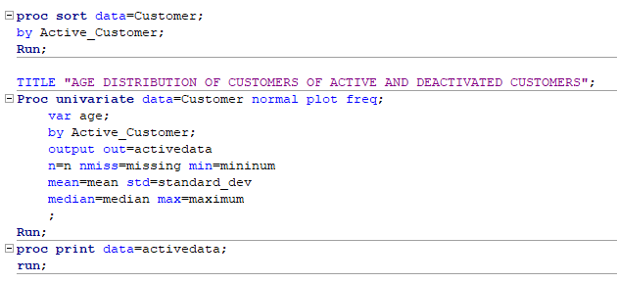
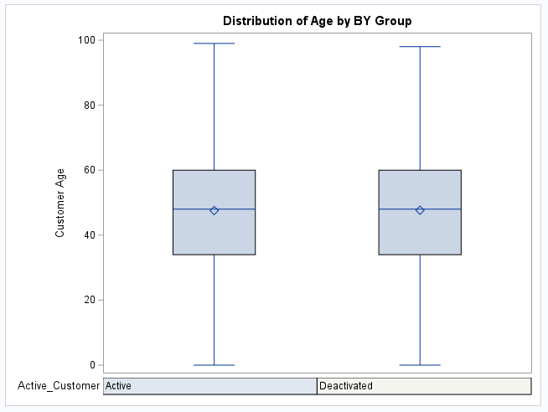
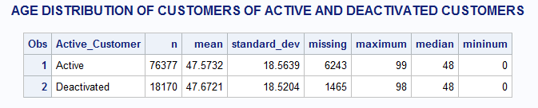
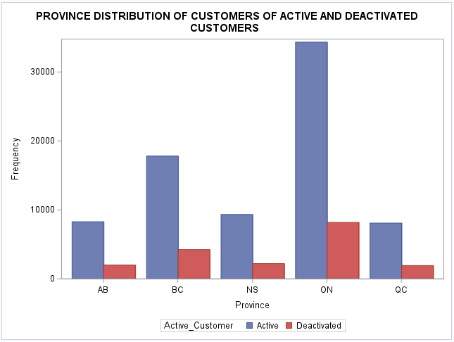
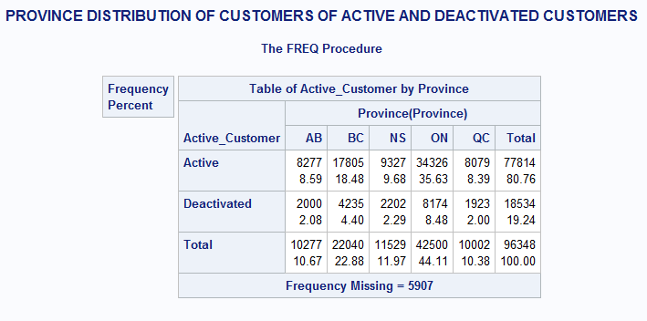
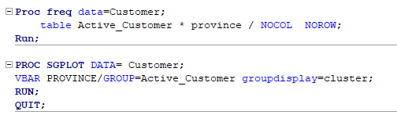
1.2 What is the age and province distributions of active and deactivated customers?
Age distribution of active and deactivated customers
Province distribution of active and deactivated customers
ONTARIO has maximum active customers and deactivated customers where Quebec has least active customers and deactivated customers.

Slide 12
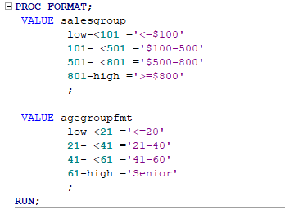
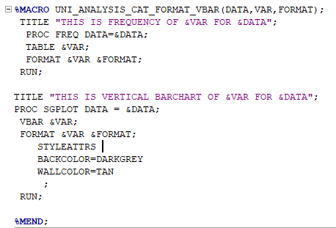
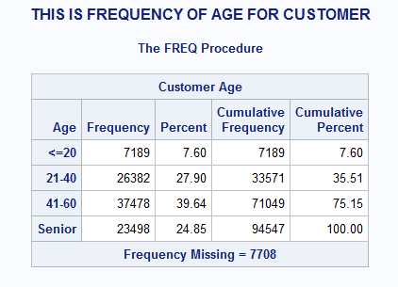
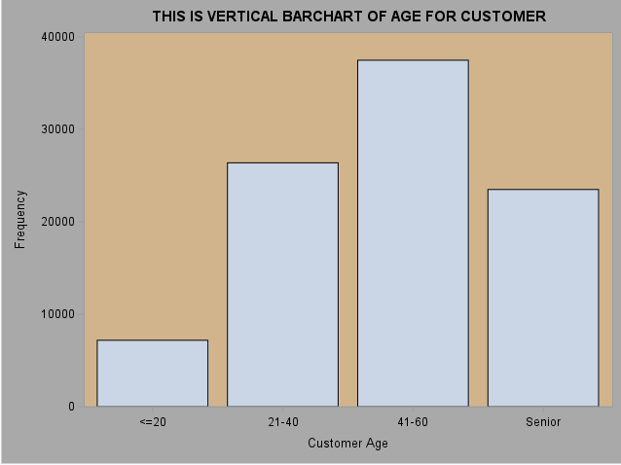
1.3 Segment the customers based on age, province, and sales amount :
Sales segment: < $100, $100---500, $500-$800, $800 and above. Age segments: < 20, 21-40, 41-60, 60 and above.
Customers by AGE segment

Slide 13
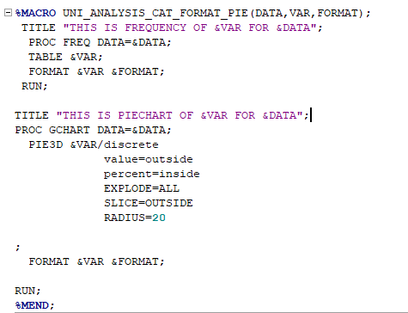
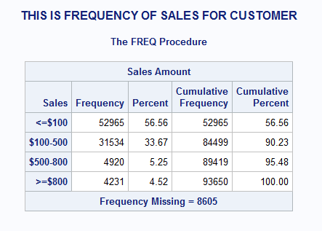
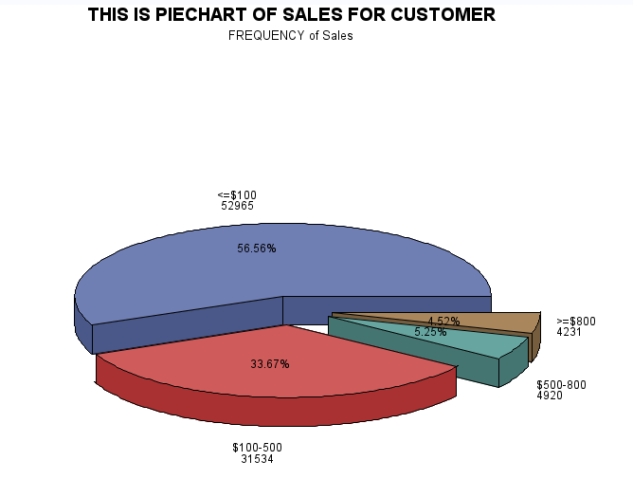

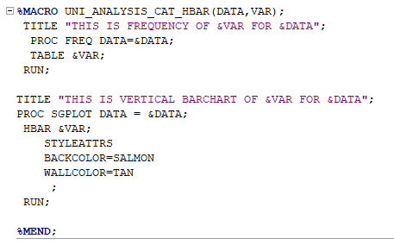
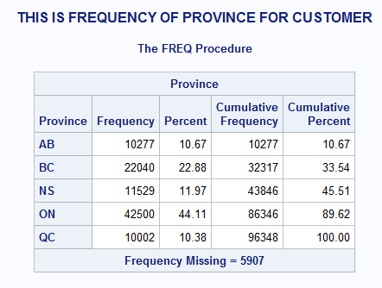
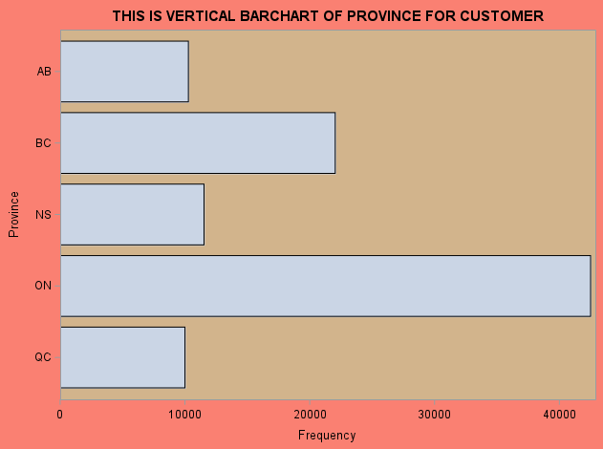
Customers by SALES segment
The Sales group “<=$100” have maximum customers and “>=800$” has the least customers.
Customers by PROVINCE segment
The maximum number of customers are in ONTARIO and least in QUEBEC province.

Slide 14
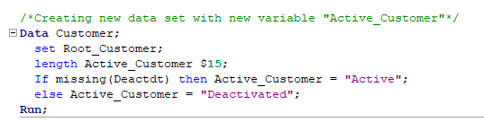
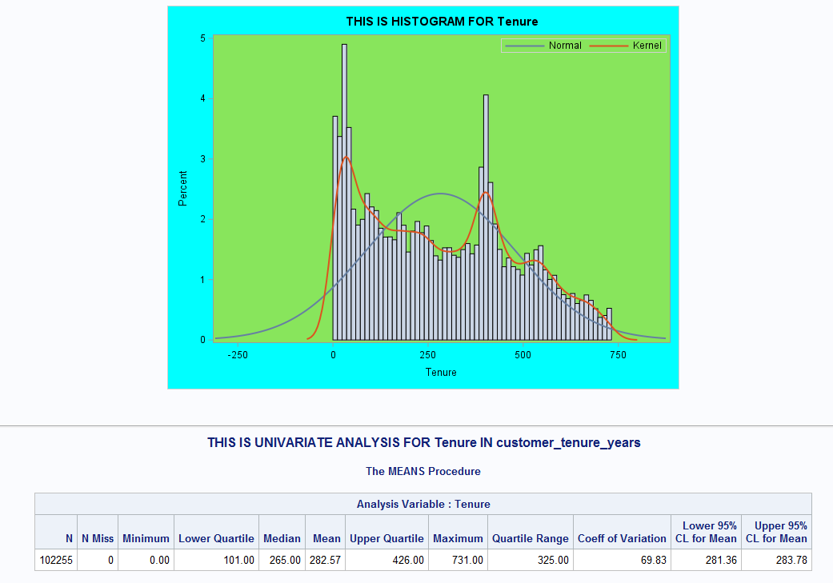
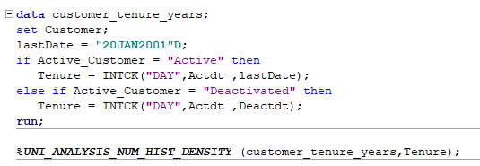
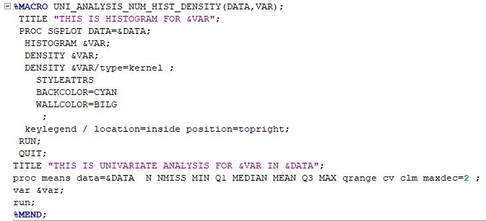
1.4. Statistical Analysis:
Calculate the tenure in days for each account and give its simple statistics.
The mean of the tenure days of customers is 282.57 days.

Slide 15


2. Calculate the number of accounts deactivated for each month
The maximum deactivations occurred in the month of December and least were in the month of February.

Slide 16


3. Segment the account, first by account status “Active” and “Deactivated”, then by Tenure: < 30 days, 31---60 days, 61 days--- one years, over one year. Report the number of accounts of percent of all for each segment.
The most of deactivated customers had belonged to tenure group “61 days – 1 year”.
Most of active customers are in the tenure group “Over 1 year”.

Slide 17



4. Test the general association between the tenure segments and “Good Credit”, “Rate Plan ” and “Dealer Type.”
Tenure segments and “Good Credit”
A chi-square test is done between the Tenure segment and Good Credit. The P-value = 0.0001 < 0.05 and hence we can reject the null hypothesis that they are independent with each other at 5% significance level.

Slide 18



Tenure segments and “Rate Plan”
A chi-square test is done between the Tenure segment and Rate Plan. The P-value = 0.0001 < 0.05 and hence we can reject the null hypothesis that they are independent with each other at 5% significance level.

Slide 19



Tenure segments and “Dealer Type”
A chi-square test is done between the Tenure segment and Dealer Type. The P-value = 0.0001 < 0.05 and hence we can reject the null hypothesis that they are independent with each other at 5% significance level.

Slide 20




5. Is there any association between the account status and the tenure segments?
Could you find out a better tenure segmentation strategy that is more associated
with the account status?

Slide 21


The distribution of tenure days shows that the tenure days is more related quadrant wise and hence a new tenure segment is made with Q1, Q2, Q3 and Q4.
The chi-square test is again performed.
We could see from the result that the Mantel-Haenszel Chi-square value have increased drastically compared to the previous tenure segmentation and hence we could conclude that the Quadrant wise tenure classification has more association with the Status-Type.
Practically, if a customer falls in first quadrant, then special care should be taken to avoid customer churn.

Slide 22




6. Does Sales amount differ among different account status, Good Credit, and customer age segments?
Does sales amount differ among different account status?
Checking the Homogeneity by Levene’s Test.
From the Levene’s test, The P-value = 0.0520 > 0.05 and hence take normal (Pooled) ttest result.
Pooled P-Val = 0.3845 > 0.05. Hence at 5% significant level we fail to reject null hypothesis that sales amount across account status are the same.

Slide 23





Does sales amount differ among different Good Credit?
Checking the Homogeneity by Levene’s Test.
Form the Levene’s test, The P-value = 0.7540 > 0.05 and hence use normal (Pooled) ttest result.
The Tukey plot explains the variance of sales in each group.
Pooled t-test P-Val = 0.8844 > 0.05. Hence at 5% significant level we fail to reject null hypothesis that sales amount for Good Credit are the same.

Slide 24




Does sales amount differ among different Age Segments?
Checking the Homogeneity by Levene’s Test.
The Tukey plot explains the variance of sales in each group.
The P-Val for Levene’s test = 0.0686 > 0.05 and hence we use the standard one-way ANOVA results i.e., P-Val = 0.4770 is considered.
Since 0.4770 > 0.05, we conclude that at 5% significant level, we fail to reject the null hypothesis that sales amount for customer age segments are similar

Slide 25
CONCLUSION
The main reasons for customer deactivation were “NEED”.
Majority of the customers have a good credit.
Customers are more inclined to have “LOW” Rate plan.
Majority of customers had “A1” as their dealer type.
ONTARIO has maximum active customers and deactivated customers where QUEBEC has least active customers and deactivated customers.
Mean age of Deactivated Customers was 47 years.
Mean Tenure of the customers is 282 days.
The maximum deactivations occurred in the month of December and least were in the month of February.
Tenure Segments is significantly related Good Credit, Rate Plan and Dealer Type.
The Sales amount does not differ among the account status, Good Credit and Customer Age Segments.

Slide 26
RECOMMENDATION
When the tenure of customers was segmented quadrant wise, it had more association with Customer status.
Hence, if a customer is in Q1, more precautions should be taken to avoid the customer churn.
As the main reason for deactivation was “NEED”, the company should know what customers “NEEDED”!
There should be policies adopted to give special care and promotions to these customers and by doing so, there is less possibility that they will be deactivated.
For EG: Old customers in Q1 can be given bonus gigs of data and additional talk time where as new customers in Q1 can be given a bill credit ($20) for a period of 1 year.

Slide 27
THANK YOU

